Slide 1
計算機組織
Introduction and Syllabus
授課教師：吳凱強
Notes:
Morgan Kaufmann Publishers
二〇二六年十一月八日
Chapter 1 — Computer Abstractions and Technology

Slide 2
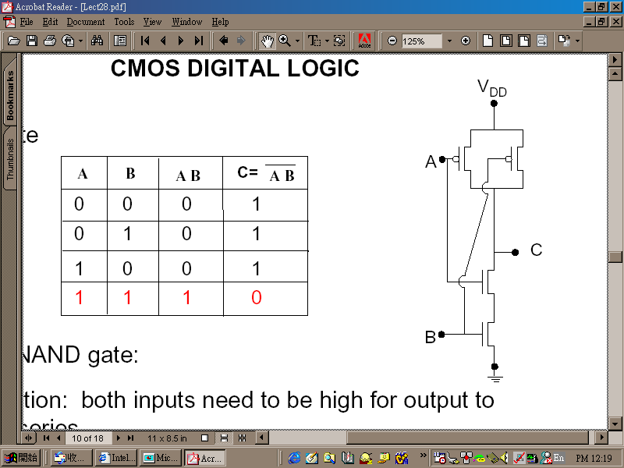
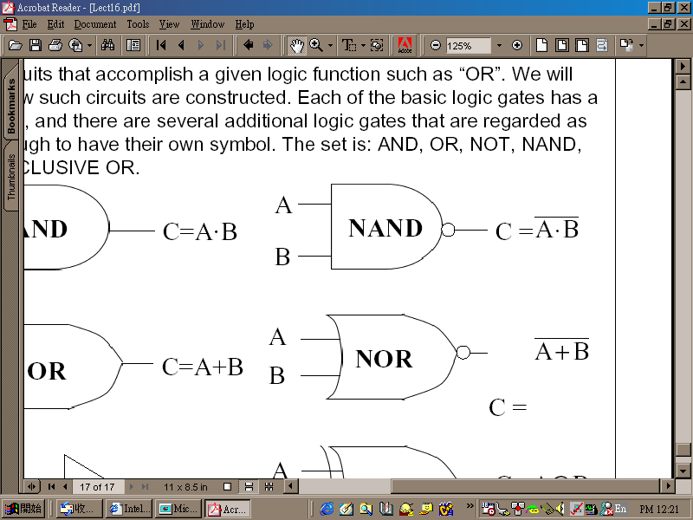
There are 10 types of people
2-input NAND gate

Slide 3
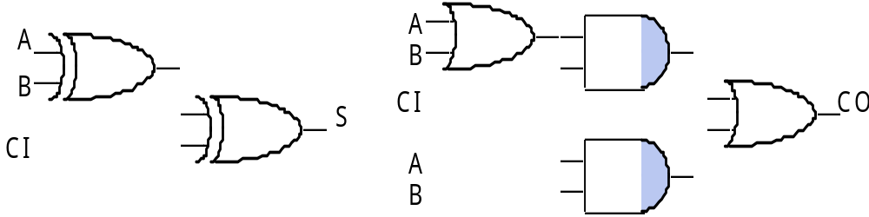
Logic
Adder
  Truth table

Slide 4

Memory
Latch
R'
R
Q
Q'
S'
S

Slide 5
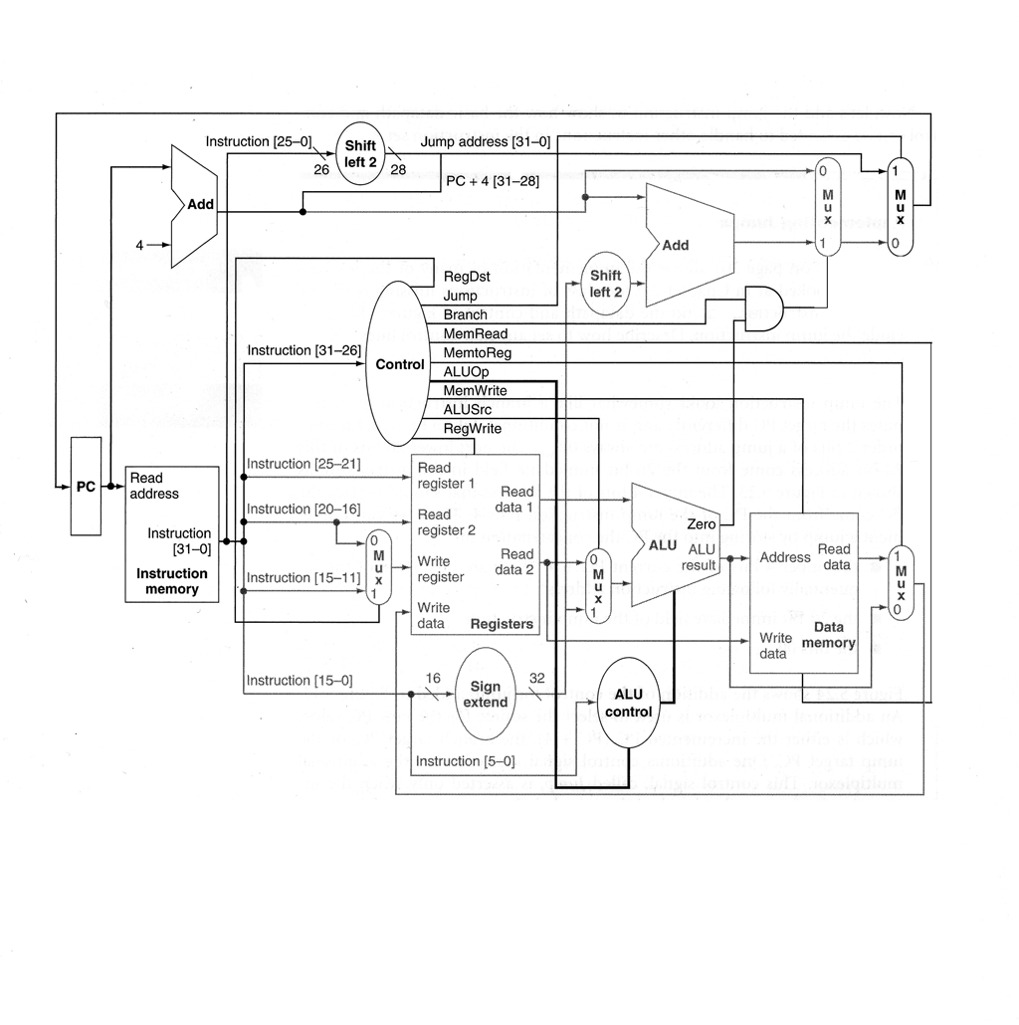
Processor

Slide 6
Computer
Application (IE)
Operating
Compiler
System
(MS Windows)
Software
Assembler
Hardware
Instruction Set
Architecture
Processor
Memory
I/O system
Datapath & Control
Digital Design
Circuit Design
Machine Organization
Transistors

Slide 7
Instruction Set Architecture
High Level Language Program
temp = v[k];
v[k] = v[k+1];
v[k+1] = temp;
Compiler
Assembly Language Program
lw $15, 0($2)
lw $16, 4($2)
sw $16, 0($2)
sw $15, 4($2)
ISA
Assembler
Machine Language Program
0000 1001 1100 0110 1010 1111 0101 1000
1010 1111 0101 1000 0000 1001 1100 0110
1100 0110 1010 1111 0101 1000 0000 1001
0101 1000 0000 1001 1100 0110 1010 1111
Machine Interpretation
Control Signal Specification
ALUOP[0:3] <= InstReg[9:11] & MASK

Slide 8
ISA Examples
Complex instruction set computer (CISC)
  Intel x86(-64)
  Intel IA-64 (Itanium architecture, 64-bit)
Reduced instruction set computer (RISC)
  ARM
  MIPS (million instructions per second)

Slide 9
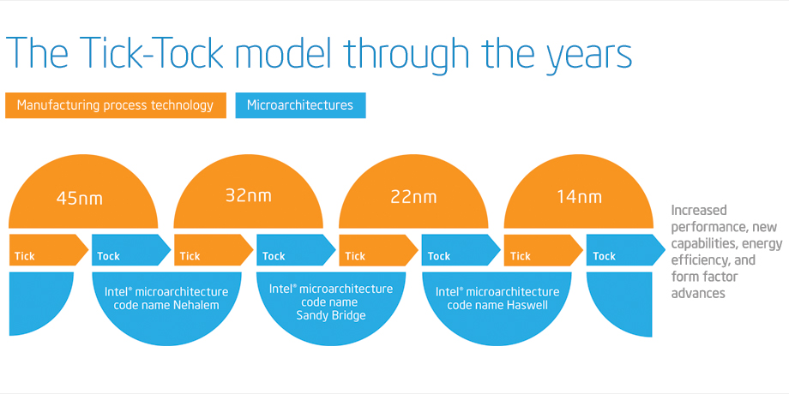
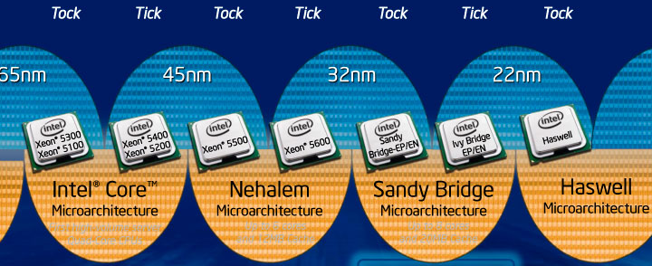
Intel’s Tick-Tock Model
Sandy Bridge, Ivy Bridge, Haswell, Broadwell, Skylake, …

Slide 10
Administrative Staff
Instructor: 吳凱強
  Tel: 54734 (校內分機)
  E-mail: kcw@cs.nctu.edu.tw
  Office: EC530
  Office hours: 1C and by appointment
Teaching assistants
  黃甯琪 (blackitty321@gmail.com)
  周煥然 (kulugu2@gmail.com)
  許賀傑 (hchsu0426@cs.nctu.edu.tw)
  李易 (nctubio@gmail.com)

Slide 11
About the Course
Prerequisites
  Digital Circuit Design (數位電路設計)
  RTL implementation with Verilog HDL
Textbook
  David A. Patterson and John L. Hennessy, Computer Organization and Design – The Hardware/Software Interface, 5th Edition, Morgan Kaufmann, 2013
Grading
  Exams: 65% (3 exams)
  Term project: 20-25% (4-5 parts + 2 demos)
  Participation/Quizzes: 10-15%
  Bonus: up to 10%
  NO CHEATING AT ALL COSTS

Slide 12
Course Details
Goal
  Learn the interface between hardware and software
  Learn the basic hardware structure of a modern programmable computer
  Learn how to design a processor, and how to design large/fast memory and storage systems
Outline
  [Chapter 1] Computer Abstractions and Technology
  [Chapter 2] Instructions: Language of the Computer
  [Chapter 3] Arithmetic for Computers
  [Chapter 4] The Processor
  [Chapter 5] Large and Fast: Exploiting Memory Hierarchy
  [Chapter 6] Storage and Other I/O Topics
  [Chapter 7] Multicores, Multiprocessors, and Clusters

Slide 13
Computer (Topics Covered)
Application (IE)
Operating
Compiler
System
(MS Windows)
Assembler (2)
Processor (3/4)
Memory (5)
I/O system (6)
Datapath & Control (4)
Digital Design
Circuit Design
Transistors

Slide 14
Processor (Chapters 3 & 4)

